Slide 1
BT2102
Assignment 1
Done By: Group 28
Members: Ashley Lee, Bryan Woo, Garion Kang, Jonathan Lim, Lai Tzu Zheng, Sarah Tan

Slide 2
Conceptual Data Model
01

Slide 3
Process of Conceptual Data Model Development
01
02
03
Identify Relationships
Identify Entities & Attributes
Determine Cardinality

Slide 4


Conceptual Data Model
ENTITIES
—BOOK
—MEMBER USER
—FINE
—PAYMENT
—ADMIN USER
01) Identifying Entities & Attributes
Strong Entity
Strong Entity
Weak Entity
Weak Entity
Strong Entity

Slide 5
Conceptual Data Model
01) Identifying Entities & Attributes (Strong)
Book Attributes
Book ID (Primary Key)
Title
ISBN
Description
Pages
Publication Date
Authors
Categories
Member User Attributes
Member ID (Primary Key)
Password
Administrative User Attributes
Admin ID (Primary Key)
Password

Slide 6
Conceptual Data Model
01) Identifying Entities & Attributes (Weak)
Fine Attributes
Fine Amount
Fine Date
*Point to Note*
Both Payment and Fine are considered weak entities as they are both dependent on member user. This will be further elaborated in the relationships which would be the next slide
Payment Attributes
Payment Amount
Payment Date

Slide 7
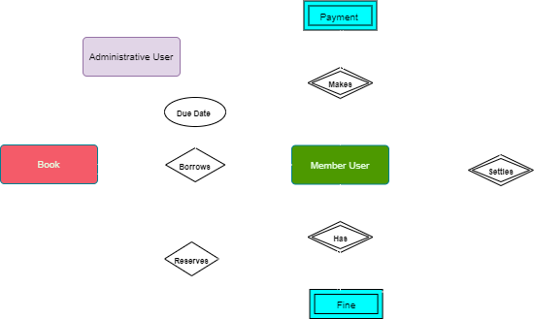
Conceptual Data Model
02) Identifying Relationships and their Attributes

Slide 8
Conceptual Data Model
02) Further elaboration on relationships and attributes
The Fine and Payment entities are weak entities that are dependent on the member user
Specifically, the fine is not a standalone and is tagged to a member user
Likewise the payment is coupled with a member user as a member user is required to make a payment
Due date
Neither an attribute of “Book” nor an attribute of “Member user”
More suitable as an attribute under the relationship of “borrows”

Slide 9
Conceptual Data Model
03) Identifying Cardinality
Member user borrows book (1 : M)
Member user reserves book (1 : M)
Member user has fine (1 : M)
Member user makes payment (1 : M)
Payment settles fine (1 : N)

Slide 10
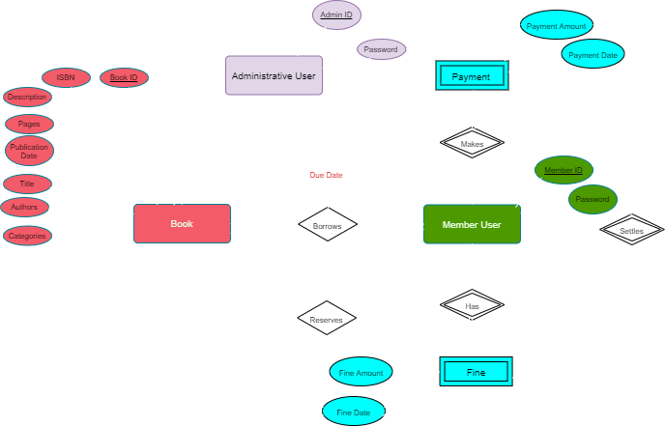
Final Conceptual Data Model

Slide 11
Logical
Data Model
02

Slide 12
Process of Logical Data Model Development
01
02
Create Relational Schemas
Refining by Normalisation or Combining schemas

Slide 13
Logical Data Model
01) Creating Relational Schemas (1 : M)
Rule: For each 1:* binary relationship, the entity on the “one side” of the relationship is designated as the parent entity and the entity on the “many side” is designated as the child entity.
Member user borrows book (1 : M)
Identify the parent entity : Member user
Identify the child entity : Book
Hence we copy the PK of member user into Book
Additional step : the due date attribute under the “borrows relation” should be included under Book(child entity)
Post a copy of the primary key attribute(s) of the parent entity into the relation representing the child entity, to act as a foreign key.

Slide 14
Logical Data Model
02) Refining schemas by Normalisation or Combining
Member user (memberID, password)
Book (bookID, bookTitle)
Member user (memberID, password)
Book (bookID, bookTitle, borrowMemberID, dateDue)
Note: we decided to use only the book id and book title attributes for the logical data model which would then be implemented in mysql because the other attributes would be used in the other database, mongodb

Slide 15
Logical Data Model
01) Creating Relational Schemas (1 : M)
Rule: For each 1:* binary relationship, the entity on the “one side” of the relationship is designated as the parent entity and the entity on the “many side” is designated as the child entity.
Member user reserves book (1 : M)
Identify the parent entity : Member user
Identify the child entity : Book
Hence we copy the PK of member user into Book
The PK will act as the foreign key of Book
Post a copy of the primary key attribute(s) of the parent entity into the relation representing the child entity, to act as a foreign key.

Slide 16
Logical Data Model
01) Creating Relational Schemas (1 : M)
Rule: For each 1:* binary relationship, the entity on the “one side” of the relationship is designated as the parent entity and the entity on the “many side” is designated as the child entity.
Member user has fine (1 : M)
Identify the parent entity : Member user
Identify the child entity : Fine
Hence we copy the PK of member user into Fine
However there is an additional step since Fine is a weak entity
Hence we create a COMPOSITE PRIMARY KEY which comprises of the PK of member user + fine date
Post a copy of the primary key attribute(s) of the parent entity into the relation representing the child entity, to act as a foreign key.

Slide 17
Logical Data Model
02) Refining schemas by Normalisation or Combining
Member user
(memberID, password)
Book
(bookID, bookTitle, borrowMemberID, reserveMemberID, dateDue)
Member user
(memberID, Password)
Book
(bookID, bookTitle, borrowMemberID, dateDue)

Slide 18
Logical Data Model
02) Refining schemas by Normalisation or Combining
Member user
(memberID, password)
Fine
(fineDate, fineAmount)
Member user
(memberID, password)
Fine
(memberID, fineDate, fineAmount)

Slide 19
Logical Data Model
01) Creating Relational Schemas (1 : M)
Rule: For each 1:* binary relationship, the entity on the “one side” of the relationship is designated as the parent entity and the entity on the “many side” is designated as the child entity.
Member user makes payment (1 : M)
Identify the parent entity : Member user
Identify the child entity : Payment
Hence we copy the PK of member user into Payment
The PK will act as the foreign key of Payment
However there is an additional step since Payment is a weak entity
Hence we create a COMPOSITE PRIMARY KEY which comprises of the PK of member user + payment date
Post a copy of the primary key attribute(s) of the parent entity into the relation representing the child entity, to act as a foreign key.

Slide 20
Logical Data Model
02) Refining schemas by Normalisation or Combining
Member user
(memberID, password)
Payment
(memberID, paymentDate, paymentAmount)
Member user
(memberID, password)
Payment
(paymentDate, paymentAmount)

Slide 21
Logical Data Model
01) Creating Relational Schemas (1 : M)
Rule: For each 1:* binary relationship, the entity on the “one side” of the relationship is designated as the parent entity and the entity on the “many side” is designated as the child entity.
Payment settles fine (1 : N)
Identify the parent entity : Payment
Identify the child entity : Fine
Hence we copy the PK of Payment into Fine
Special case: Payment is a weak entity hence its Primary Key consists of memberID + paymentDate
Hence the composite primary key will be the foreign key of Fine
Post a copy of the primary key attribute(s) of the parent entity into the relation representing the child entity, to act as a foreign key.

Slide 22
Logical Data Model
02) Refining schemas by Normalisation or Combining
Fine
(memberID, fineDate, fineAmount)
Payment
(memberID, paymentDate, paymentAmount)
Fine
(memberID, fineDate, paymentDate, fineAmount)
Payment
(memberID, paymentDate, paymentAmount)

Slide 23
Final Logical Data Model
Book (bookID, bookTitle, borrowMemberID, reserveMemberID, dateDue)
PK: bookID
FK: borrowMemberID references MemberUser(memberID)
FK: reserveMemberID references MemberUser(memberID)
MemberUser (memberID, memberPassword)
PK: memberID
AdminUser (adminID, adminPassword)
PK: adminID
Payment (memberID, paymentDate, paymentAmount)
PK: (memberID, paymentDate)
FK: memberID references MemberUser(memberID)
Fine (memberID, fineDate, paymentDate, fineAmount)
PK: (memberID, fineDate)
FK: memberID references MemberUser(memberID)
FK: (memberID, paymentDate) references Payment(memberID, paymentDate)

Slide 24
THANKS
Please keep this slide for attribution

